Slide 1
Radiometry for Coloured Lights
Spectral Quantities

Slide 2
Spectral Quantities
Spectral quantities depends on optical frequency and wavelength
Optical frequency –
the oscillation frequency of the corresponding electromagnetic wave.
For visible light, optical frequencies are roughly between 400 THz (terahertz = 10¹² Hz = 1 trillion hertz) and 700 THz
Infrared light has lower optical frequencies, while ultraviolet light has higher frequencies
Wavelength
the distance between successive crests of a wave, especially points in a sound wave or electromagnetic wave.

Slide 3
Radiance and Spectral radiance
In radiometry, radiance is the radiant flux emitted, reflected, transmitted or received by a given surface, per unit solid angle per unit projected area.
Spectral radiance is the radiance of a surface per unit wavelength.
Radiance emitted in the range of wavelengths [λ, λ + dλ]
Spectral radiance is usually written as L^{λ}(x, θ, φ) So it can be written as L^{λ}(x, θ, φ)dλ.
These are directional quantities.
The SI unit of radiance is the watt per steradian per square metre (W sr⁻¹ m⁻²)
Spectral radiance in wavelength is the watt per steradian per square metre per metre (W·sr⁻¹·m⁻³)—Watts per cubic meter per steradian

Slide 4
Exitance and Spectral Exitance
Angular distribution of the source is unimportant, then consider spectral exitance
In radiometry, radiant exitance or radiant emittance is the radiant flux emitted by a surface per unit area,
Spectral exitance or spectral emittance is the radiant exitance of a surface per unit frequency or wavelength, depending on whether the spectrum is taken as a function of frequency or of wavelength.
The SI unit of radiant exitance is the watt per square metre (W/m²),
Spectral exitance in frequency is the watt per square metre per hertz (W m⁻² Hz⁻¹)
spectral exitance in wavelength is the watt per square metre per metre (W m⁻³)

Slide 5

BRDF and Spectral BRDF
A function which defines the spectral and spatial reflection characteristic of a surface.
The BRDF of a surface is the ratio of reflected radiance to incident irradiance at a particular wavelength
In radiometry, irradiance is the radiant flux (power) received by a surface per unit area.
The SI unit of irradiance is the watt per square metre (W m⁻²).
Spectral irradiance is the irradiance of a surface per unit frequency or wavelength, depending on whether the spectrum is taken as a function of frequency or of wavelength.
spectral BRDF is obtained by considering the ratio of the spectral radiance in the outgoing direction to the spectral irradiance in the incident direction.
Because the BRDF is defined by a ratio, the spectral BRDF will again have units sr⁻¹.

Slide 6
The Colour of Surfaces
Refraction is the change in direction of a wave passing from one medium to another
Diffraction - the process by which a beam of light is spread out as a result of passing through a narrow aperture or across an edge
Diffraction is bending or spreading of waves around an obstacle, while refraction is bending of waves due to change of speed.
Both diffraction and refraction are wavelength dependant.
Hence, both can split white light in to its component wavelengths.
We are able to see the color of the coloured surfaces due to differential absorbtion at different wavelengths, refraction, diffraction and bulk scattering

Slide 7
Usually these effects are bundled into a macroscopic BRDF model, which is typically a Lambertian plus specular approximation
The Lambertian diffuse model assumes that light reflected from a rough surface is dependent only on the surface normal and light direction, and therefore a Lambertian surface is equally bright in all directions.
A specular surface is a highly smooth surface. When the surface is very smooth, the reflected light is easy to see. As the surface becomes rougher, the reflected lights gets broader and dimmer.
The terms are now spectral reflectance (sometimes abbreviated to reflectance) or (less commonly) spectral albedo.
Spectral Reflectance is a measure of how much energy (as a percent) a surface reflects at a specific wavelength. Many surfaces reflect different amount of energy in different portions of the spectrum.
Surface Albedo (SURFALB), defined as the ratio between solar radiation reflected by Earth's surface and solar radiation incident at the surface
It is a function of both solar illumination and the surface reflective properties.

Slide 8
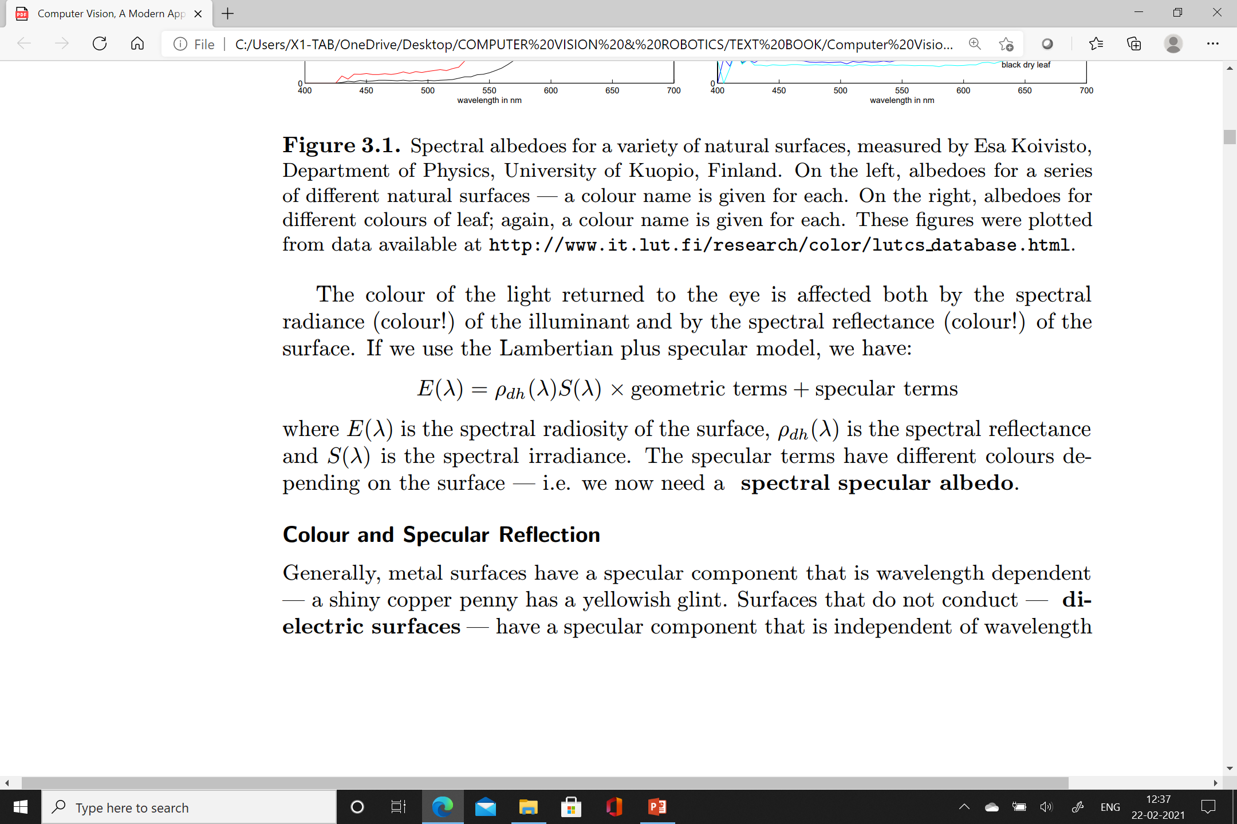

Slide 9
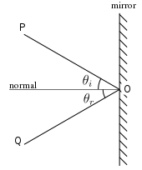
Colour and Specular Reflection
In specular reflection, the incident light is reflected into a single outgoing direction.
Specular reflection, or regular reflection, is the mirror-like reflection of waves, such as light, from a surface.
The law of reflection states that a reflected ray of light emerges from the reflecting surface at the same angle to the surface normal as the incident ray, but on the opposing side of the surface normal in the plane formed by the incident and reflected rays.
Metal surfaces have a specular component and it is wavelength dependent — a shiny copper penny has a yellowish glint.
Surfaces that do not conduct — dielectric surfaces — have a specular component that is independent of wavelength

Slide 10
The Colour of Sources
Building a light source - it usually involve heating something until it glows.
Black Body Radiators
A body that reflects no light
It is usually called a black body
A black body is an idealized physical body that absorbs all incident electromagnetic radiation, regardless of frequency or angle of incidence.
The name "black body" is given because it absorbs radiation in all frequencies,
It not only absorbs: a black body can emit black-body radiation
Black-body radiation is the thermal electromagnetic radiation within or surrounding a body emitted by a black body
It is the most efficient radiator of illumination.
A heated black body emits electromagnetic radiation.
Spectral power distribution of this radiation depends only on the temperature of the body
It is possible to build good black bodies so that the spectral power distribution can be measured.

Slide 11
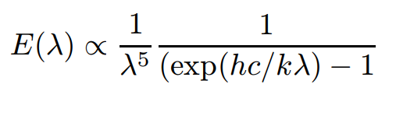
Black body radiation
In particular, if we write
T for the temperature of the body in Kelvins,
h for Planck’s constant, is a proportionality constant between the energy carried by a photon and the frequency of its associated electromagnetic wave (6.62607015 × 10⁻³⁴).
k for Boltzmann’s constant - the proportionality factor that relates the average relative kinetic energy of particles in a gas with the thermodynamic temperature of the gas (1.380649 × 10⁻²³ ).
c for the speed of light and
λ for the wavelength

Slide 12
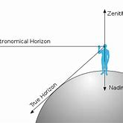
The Sun and the Sky
The most important natural light source is the sun.
The sun is usually modelled as a distant, bright point.
The colour of sunlight varies with time of day and time of year
The sky is another important natural light source.
The crude (basic) geometrical model is a hemisphere with constant exitance.
The zenith is an imaginary point directly "above" a particular location, on the imaginary celestial sphere
The assumption that exitance is constant is poor, however, because the sky is substantially brighter at the horizon than at the zenith.
The sky is bright because light from the sun is scattered by the air.

Slide 13
The natural model is to consider air is emitting a constant amount of light per unit volume;
This means that the sky is brighter on the horizon than at the zenith, because a viewing ray along the horizon passes through more sky.
For clear air, the intensity of radiation scattered by a unit volume depends on the fourth power of the frequency;
Intensity of the scattered light increases as the fourth power of its frequency; this strong dependence on frequency explains the colour of the sunlit sky.
this means that light of a long wavelength can travel very much further before being scattered than light of a short wavelength (this is known as Rayleigh scattering).
This means that, when the sun is high in the sky, blue light is scattered out of the ray from the sun to the earth — meaning that the sun looks yellow — and can scatter from the sky into the eye — meaning that the sky looks blue.

Slide 14
Artificial Illumination
Typical artificial light sources are very small in number
An incandescent light bulb or light source is any device that uses electricity to heat a filament—or wire—until it is hot enough to glow white
An incandescent light contains a metal filament which is heated to a high temperature.
This follows the black-body law, meaning that incandescent lights have a reddish tinge
Fluorescent lights work by generating high speed electrons that strike gas within the bulb;
this in turn releases ultraviolet radiation, which causes phosphors coating the inside of the bulb to fluoresce.
Typically the coating consists of three or four phosphors, which fluoresce in quite narrow ranges of wavelengths.
A fluorescent lamp, or fluorescent tube, is a low-pressure mercury-vapor gas-discharge lamp that uses fluorescence to produce visible light. An electric current in the gas excites mercury vapor, which produces short-wave ultraviolet light that then causes a phosphor coating on the inside of the lamp to glow
Most fluorescent bulbs generate light with a bluish tinge, but bulbs that mimic natural daylight are increasingly available

Slide 15
In some bulbs, an arc is struck in an atmosphere consisting of gaseous metals and inert gases.
Light is produced by electrons in metal atoms
The electrons drop from an excited state to a lower energy state.
Such lamps have strong radiation at small number of wavelengths, which corresponds to the state transitions
The most common cases are sodium arc lamps, and mercury arc lamps.
Sodium arc lamps produce a yellow-orange light extremely efficiently, and are quite commonly used for freeway lighting.
Mercury arc lamps produce a blue-white light, and are often used for security lighting

Slide 16
Human Colour Perception
Human perception of colour is a complex function
illumination, memory, object identity and emotion can all play a part.

Slide 17
Colour Matching
The simplest case of colour perception is obtained when only two colours are in view, on a black background.
In a typical experiment a subject sees a coloured light — the test light — in one half of a split field.
The subject can then adjust a mixture of lights in the other half to get it to match.
The adjustments involve changing the intensity of some fixed number of primaries in the mixture.
In this form, a large number of lights may be required to obtain a match, but many different adjustments may yield a match.

Slide 18
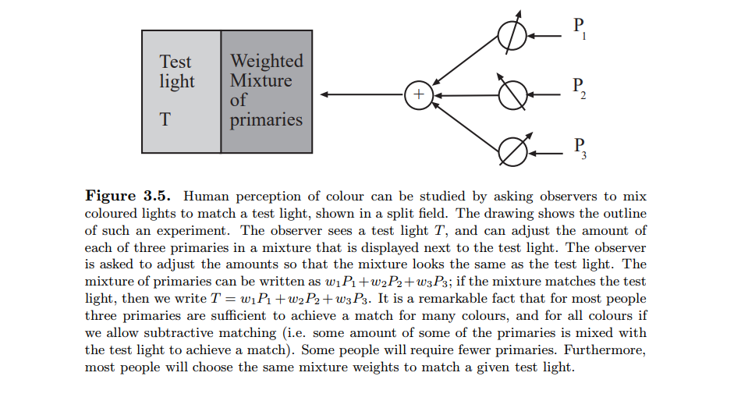

Slide 19
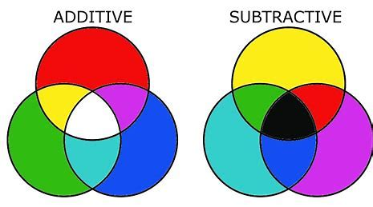
A match can then written in an algebraic form as
T = w₁P₁ + w₂P₂ + ...
T for the test light,
the weights w_{i} and the primaries P_{i} are non-negative.
meaning that test light T matches the particular mixture of primaries given by (w1, w2, w3).
This is called additive matching
The situation is simplified if subtractive matching is allowed:
in subtractive matching, the viewer can add some amount of some primaries to the test light instead of to the match.
This can be written in algebraic form by allowing the weights in the expression above to be negative.

Slide 20
Trichromacy
Trichromacy or trichromatism is the possessing of three independent channels for conveying color information, derived from the three different types of cone cells in the eye.
Organisms with trichromacy are called trichromats.
The normal explanation of trichromacy is that the organism's retina contains three types of color receptors (called cone cells in vertebrates) with different absorption spectra.
It is an experimental fact that for most observers only three primaries are required to match a test light.
There are some caveats (limitations).
Firstly, subtractive matching must be allowed
Secondly, the primaries must be independent
That means, mixture of two of the primaries may not match a third. This phenomenon is known as the principle of trichromacy.

Slide 21
It is a remarkable fact that,
given the same primaries and the same test light,
most observers will select the same mixture of primaries to match that test light.
This phenomenon is usually explained by assuming that the three distinct types of colour transducer are common to most people.

Slide 22
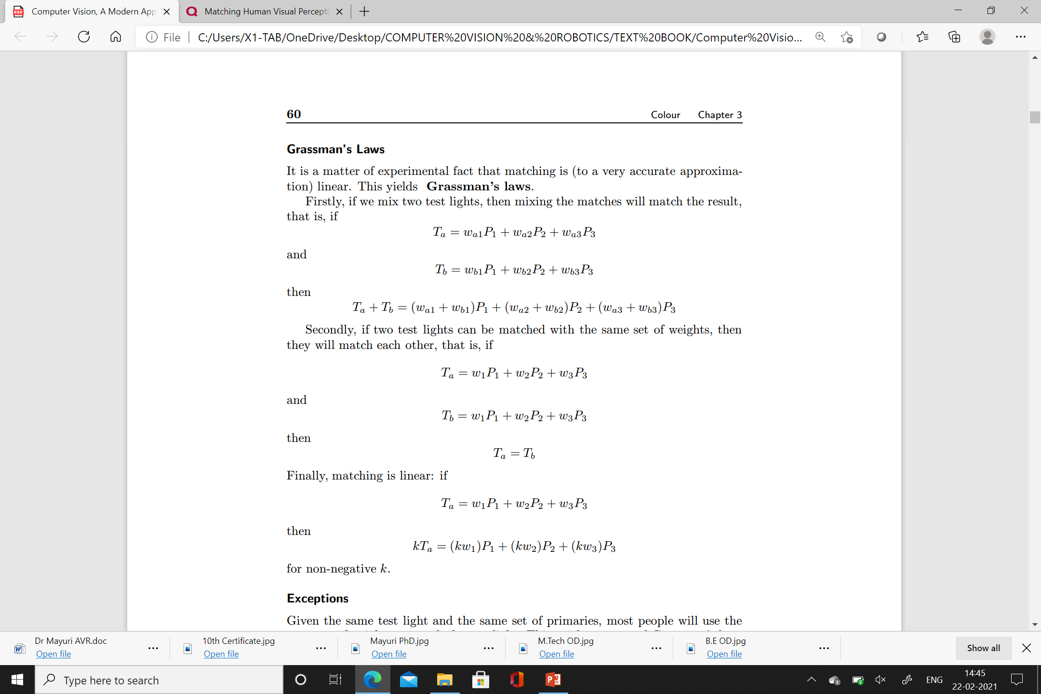
Grassman’s Law

Slide 23
Colour Receptors
Trichromacy suggests that there are profound constraints on the way colour is transduced in the eye.
One hypothesis that satisfactorily explains this phenomenon is to assume that there are three distinct types of receptor in the eye that mediate colour perception.
Each of these receptors turns incident light into neural signals.
If two test lights that have different spectra look the same, then they must have the same effect on these receptors.

Slide 24
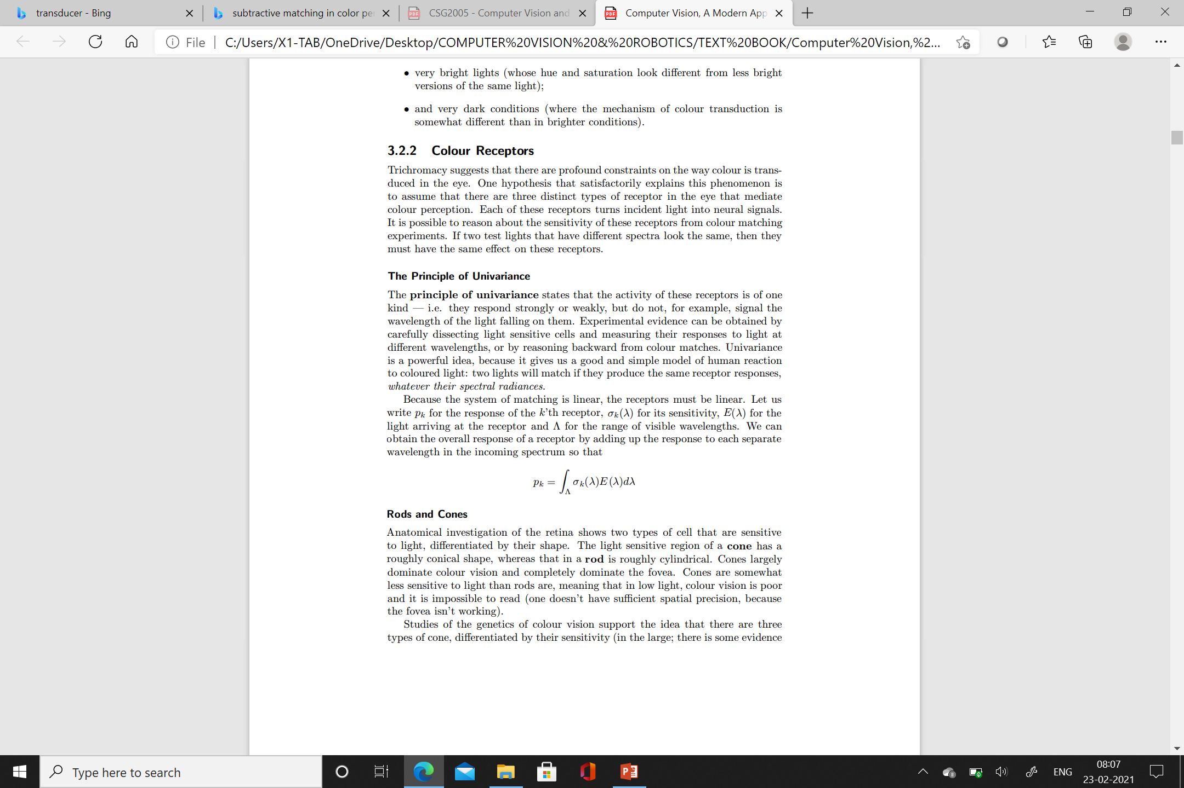
The principle of univariance states that the activity of these receptors is of one kind — i.e. they respond strongly or weakly
Univariance is a powerful idea, because it gives us a good and simple model of human reaction to coloured light:
two lights will match if they produce the same receptor responses, whatever may be their spectral radiances
Because the system of matching is linear, the receptors must be linear.
Consider p_{k} for the response of the k’th receptor, σ_{k}(λ) for its sensitivity, E(λ) for the light arriving at the receptor and λ for the range of visible wavelengths.
We can obtain the overall response of a receptor by adding up the response to each separate wavelength in the incoming spectrum

Slide 25
Rods and Cones
Anatomical investigation of the retina shows two types of cell that are sensitive to light, differentiated by their shape.
The light sensitive region of a cone has a roughly conical shape,
The light sensitive region of a rod is roughly cylindrical shape.
Cones largely dominate colour vision and completely dominate the fovea.
The fovea is a small composed of closely packed cones in the eye.
The fovea is responsible for sharp central vision, which is necessary in humans for performing visual activities such as reading and driving.
Cones are somewhat less sensitive to light than rods
This means that in low light, colour vision is poor and it is impossible to read

Slide 26
There are three types of cone, differentiated by their sensitivity
The sensitivities of the three different kinds of receptor to different wavelengths can be obtained by comparing colour matching data for normal observers with colour matching data for observers lacking one type of cone
The three types of cone are properly called S cones, M cones and L cones
The peak sensitivity being to short, medium and long wavelength light respectively
They are occasionally called blue, green and red cones

Slide 27
Representing Colour
Colour matching data yields simple and highly effective linear colour spaces
Specific applications may require colour spaces that emphasize particular properties
uniform colour spaces, which capture the significance of colour differences .

Slide 28
Linear Colour Spaces
Mechanism for representing colour:
1. Agree on a standard set of primaries,
Then describe any coloured light by the three values of the weights that people would use to match the light using those primaries.
By using this is easy to describe a colour
If we use a standard light for illuminating the surface, then this approach can be extended to give a representation for surface colours

Slide 29
Colour Matching Functions
Simple algorithm can be constructed when colours are mixed linearly
Given a set of primaries, this algorithm determine which weights would be used to match a source whose spectral radiance is known.
The spectral radiance of the source is a weighted sum of single wavelength sources.
Because colour matching is linear, the combination of primaries that matches a weighted sum of single wavelength sources is obtained by matching the primaries to each of the single wavelength sources, and then adding up these match weights.

Slide 30
If we have a record of the weight of each primary required to match a single wavelength source — a set of colour matching functions can be determined.
We can write the color matching functions as f1(λ), f2(λ) and f3(λ) — that can be obtained from a set of primaries P1, P2 and P3.
we tune the weight of each primary to match a unit radiance source at every wavelength.
We then obtain a set of weights, one for each wavelength, for matching a unit radiance source U(λ).
We can write this process as
U(λ) = f1(λ)P1 + f2(λ)P2 + f3(λ)P3
i.e. at each wavelength λ, f1(λ), f2(λ) and f3(λ) give the weights required to match a unit radiance source at that wavelength.

Slide 31

The source S(λ) — is a sum of a vast number of single wavelength sources, each with a different intensity.
We now match the primaries to each of the single wavelength sources, and then add up these match weights, obtaining
S(λ) = w1P1 + w2P2 + w3P3
= {$\int_{λ}{\text{f}\text{1(}\text{λ}\text{)}\text{S}\text{(}\text{λ}\text{)}\text{d}\text{λ}}$} P1 + {$\int_{λ}{\text{f}\text{2}\text{(}\text{λ}\text{)}\text{S}\text{(}\text{λ}\text{)}\text{d}\text{λ}}$} P2 + {$\int_{λ}{\text{f}\text{3}\text{(}\text{λ}\text{)}\text{S}\text{(}\text{λ}\text{)}\text{d}\text{λ}}$} P3

Slide 32
Color Model – Refer ClassNoteBook
CIE
RGB
CMY
HSL
HSV

